Slide 1

Otterdam Technology Group L.L.C.
Special Use permit request – site overview and plans
Greensville County Planning Commission Meeting
October 14, 2025
Jamie Craig – l.l.c. manager and brian c. Purcell esq., counsel to “OTG”

Slide 2
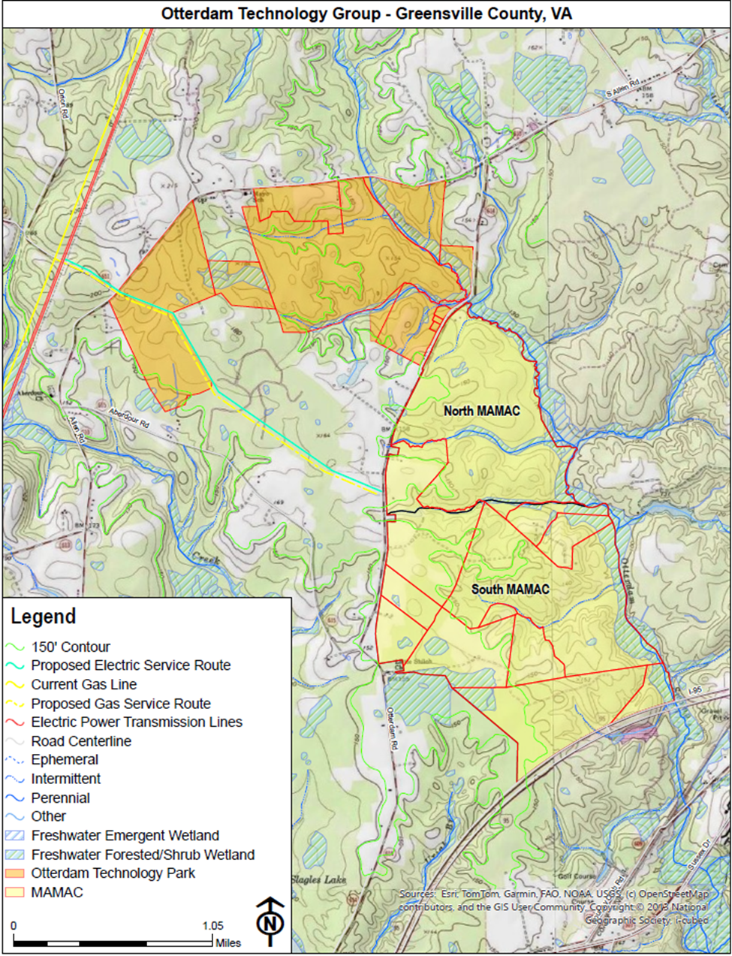
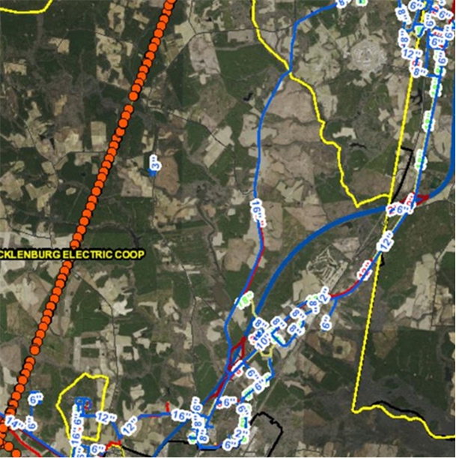
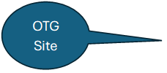
Site plan and overview Topographical View
excluded
OTG

Slide 3
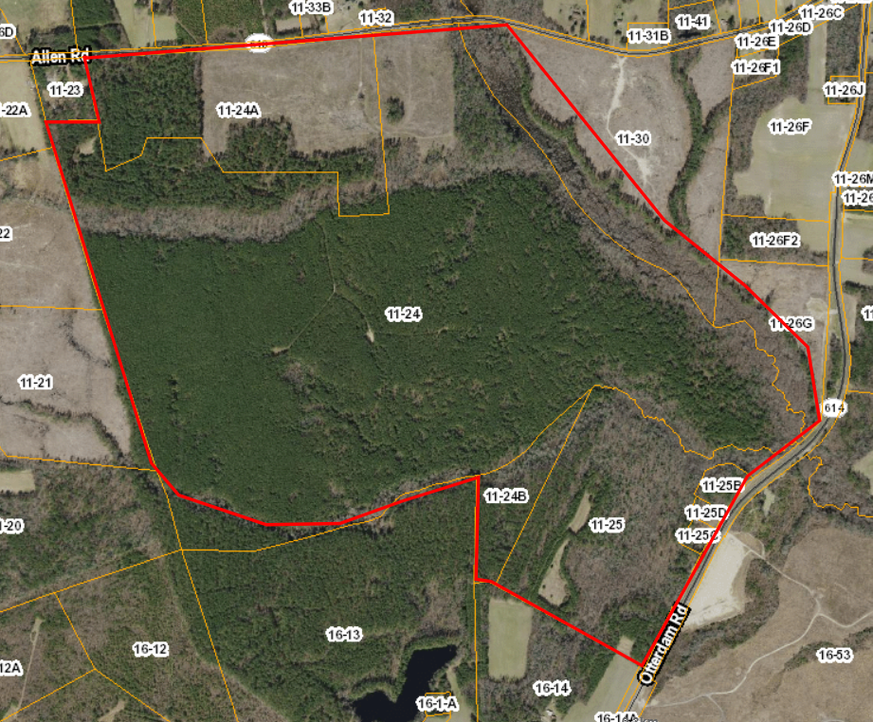
Basic Site Overview and parcel listing
The OTG site includes the following Tax parcels as part of the assemblage:
11-24
11-24A
11-24B
11-25, 25B, 25C, & 25D,
11-26G (part)
11-30 (part)
The total acres included are ~495 +/-
OTG controls 11-21 but has not included this in the proposal.

Slide 4
Proximity to Adjacent Residences
Adjacent residences shown in yellow circles with approximate distance to main site buildings
Allen Road - ~ 1,500 ft
Turner (11-23) ~1,350 ft
Tyler (11-26F) ~2,100 ft
Scott (11-26J) >2,100 ft
Fladung – (11-20) ~1,800 ft
Main area of development
Data centers located here
Office & Maintenance yard

Slide 5

Site Readiness Status
Wetlands Delineation is complete. All streams will be bridged and expected wetland impacts are within norms per Wetland Studies and Solutions, LLC.
Natural Heritage analysis is complete. No expected impacts to species are anticipated.
Cultural Resources assessment is complete. No impacts were identified on site.
EPA Phase 1 completed, no issues identified, or remediation recommended.
Power Assessment and delivery study coordinated between MEC, Truss Energy, and Axial Energy Engineering (a subcontractor to Dominion Power) – response due late Spring 2026

Slide 6
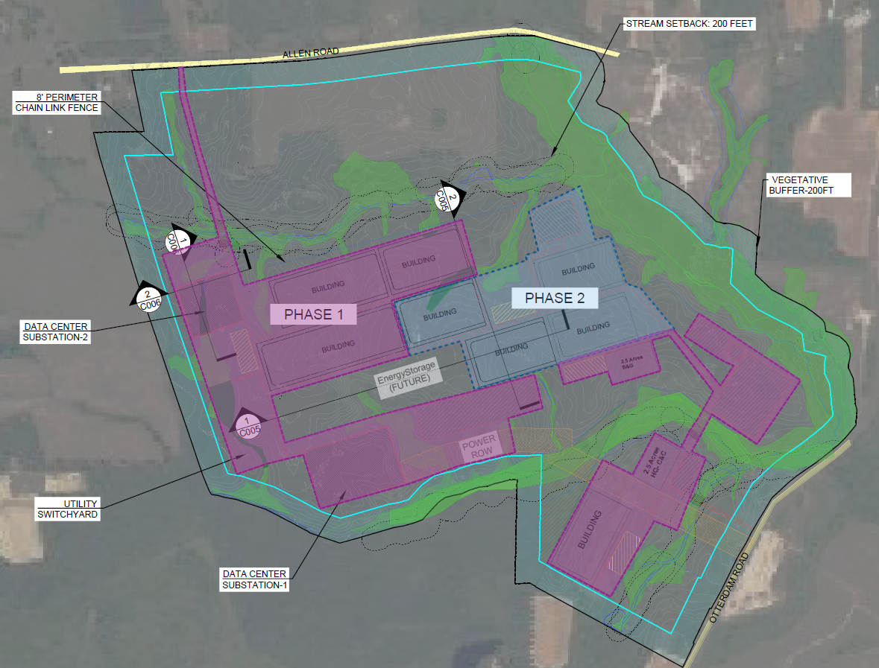
Site plan and aerial overview
Phase 1
Main entrance on Otterdam Road
300 MW of Data Center buildings
One 300MW Substation/switchyard
Control Center and Buildings and Grounds yard
Emergency ingress/egress for 911 on Allen Road
Phase 2
300 MW Data Center Buildings
One 300 MW Substation

Slide 7
Reasons to support this project plan as presented
Reasons to support this project design on this site:
Property is within the Technology Overlay Distritct ( “TOD”) as approved the Greensville County Board of Supervisors.
Short Parcel (11-25) will be used as primary point of entry via Otterdam Road.
The entire Veiliky parcel (11-24A) is included and is being left as “green space” to shield Allen Road.
OTG incorporated all small parcels contiguous to site to avoid impacts (Mitchell 11-25C&D and Jack-Jones 11-25B)
A minimum 200-foot forested buffer has been incorporated into the site plan to ensure minimal visual impacts.
Project design is sensitive to surrounding residential landowners and will be virtually invisible to them.
Impervious surface expected to be ~40% (186ac out of 495ac) of the total acres, well within the TOD limits.
Property owners “stranded” 250 acres of TOD approved land; avoids impacts to residences on western end of project site.

Slide 8
Infrastructure support
Water line on site from Jarratt supply site.
Sewer about 1.5 miles south on Otterdam Road.
Power and Gas ROW cross adjacent lands owned by OTG.
Secondary ROW planned for eastern supply route if needed.
400 GB mainline MABB fiber 3 miles south of site, ROW exists along Otterdam Road to serve site.

Slide 9
Infrastructure support this project plan
Economic Infrastructure reasons:
MAMaC is rumored to be developing Data Centers on its northern lands.
The cost to develop, upgrade, and deliver the requisite infrastructure (Water, Sewer, Power, Gas, Fiber) is very high.
Concentrating Data Center development in one area allows for cost share between multiple end users
Multiple end-users de-risks the build out cost to upgrade county owned utilities – not single client reliant.
Multi end-user contracts with Greensville County enable public market offering to finance upgrades to Water & Sewer.
Potential cost savings/sharing for all utility upgrades and service to MAMaC as well.

Slide 10
High level summary of economic impacts
✅ Key Benefits of a Data Center in Greensville County
Major Capital Investment Brings hundreds of millions of dollars in construction spending, supporting local contractors and trades.
High-Wage Job Creation Generates >100 permanent skilled jobs (IT, maintenance, security), with opportunities for local upskilling.
Expanded Tax Base Increases property and business tax revenue to fund schools, public safety, and infrastructure.
Broadband & Utility Upgrades Drives improvements in fiber connectivity, power infrastructure, and water systems—benefiting residents and future businesses.
Technology Branding Positions Greensville as a tech-friendly location, attracting future investment in logistics, data services, or renewable energy.
Educational & Workforce Development Opportunities Can be linked with Southside Virginia Community College and local schools to build STEM and IT career pipelines.

Slide 11

Thank You
jamie@beechtree.biz
bpurcell@wilsav.com

