Slide 1


The "Upards",
Tangier Island, Va
Overview and approval request for acceptance of fees simple gift of 175 acres located on the Northern Island of Tangier Island in Accomack County, VA
Thursday October 16, 2014 Beechtree Group, LLC

Slide 2
The "Upards", Tangier Island, Va
Introduction to Property
Ownership History
Wildlife Benefits
Transaction Proposal
Q & A
Beechtree Group, LLC October 16, 2014 VDGIF

Slide 3
The "Upards", Tangier Island, VA
October 1993 - Three friends and hunting buddies go to St. Amboise near the Delta Marsh in Manitoba Canada…
January 2014 – two friends are sitting in a goose pit in Queenstown Maryland…
October 2014 – here we are.
Source:
Pages 106, GODS ISLAND The History of Tangier written by Kirk Mariner.

Slide 4
The "Upards", Tangier Island, VA
Source:
Page 27 GODS ISLAND The History of Tangier written by Kirk Mariner.

Slide 5
The "Upards", Tangier Island, VA
Source: Accomack Court House, DB 0671 Page 0228
Recorded July 27, 1994

Slide 6
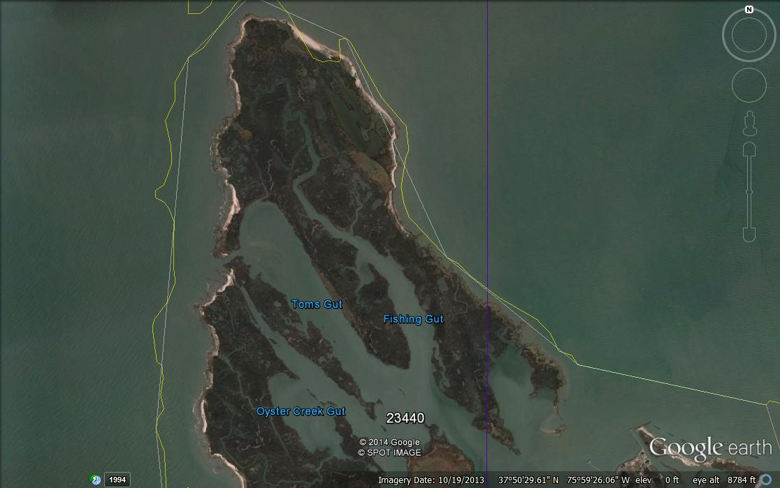
The "Upards", Tangier Island, VA
Shorebird
Colonies
Rubentown
Dutson Tract
175 acre (deed)

Slide 7
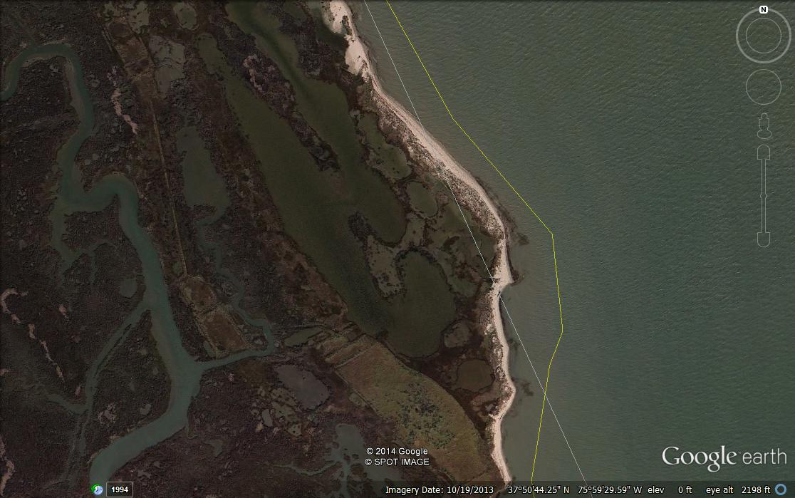
The "Upards", Tangier Island, VA

Slide 8
The "Upards", Tangier Island, VA
Wildlife Benefits:
  Site contains registered Natural Heritage Sites –
    (2) Nesting Shorebird colonies shown on property
      breeding oystercatchers, willets, and clapper rails as well as seaside sparrows and other marsh dependent species
    Ground Nesting Osprey (atypical)
    Substantial marsh area – supports wintering waterfowl
      mallards, black ducks, gadwall, widgeon, redheads, bufflehead, ruddy ducks, many sea ducks, brant, and Tundra swans
    Aquatic species dependent on marsh grasses for nesting, brood rearing, and lifespan habitat.
Historic Benefits
  Documented 19th century fishing village ruins, gravesites, and road remnants could yield, if explored or excavated, substantial insight into the life and times of early settlers on Tangier.
PR Benefits:
  DGIF is interested in accepting this then transferring ownership to the town of Tangiers to create a public marsh for the benefit of all its citizens.

Slide 9
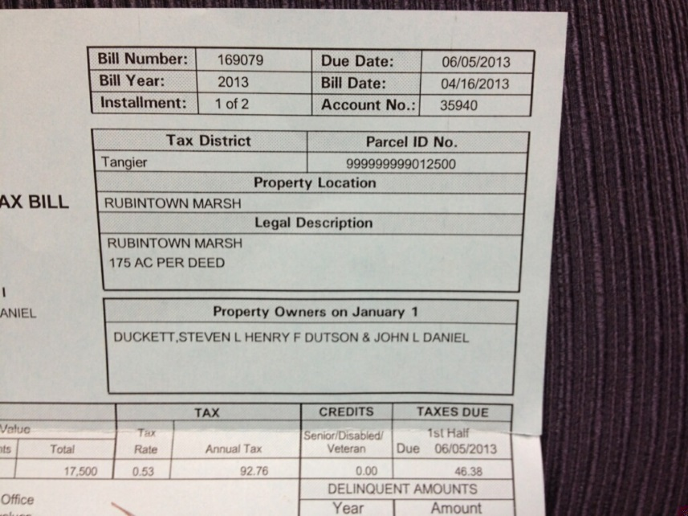
The "Upards",
Tangier Island, VA
So, why are we here?
The families wish to make a gift of this to the Town of Tangier in honor of Steven L. Duckett, who was the mastermind behind the acquisition of this property.
We will require Town Council approval to accept the gift. The owner and I will come to Tangier on May 4th to make a presentation to Town Council and gain approval to receive the gift . Once they agree to accept, the closing will be in about 90 days.
Questions?

